Slide 1
RoadMap for DataScience
PythonLife

Slide 2
Steps to Become data Scientist
Maths Fundamentals
Programming
Statistics
Data Wrangling
Data Visualization
Machine Learning
Projects and DS Competations
Interview preparation

Slide 3
Deep Learning
Big Data
Version control
Data scientist

Slide 4
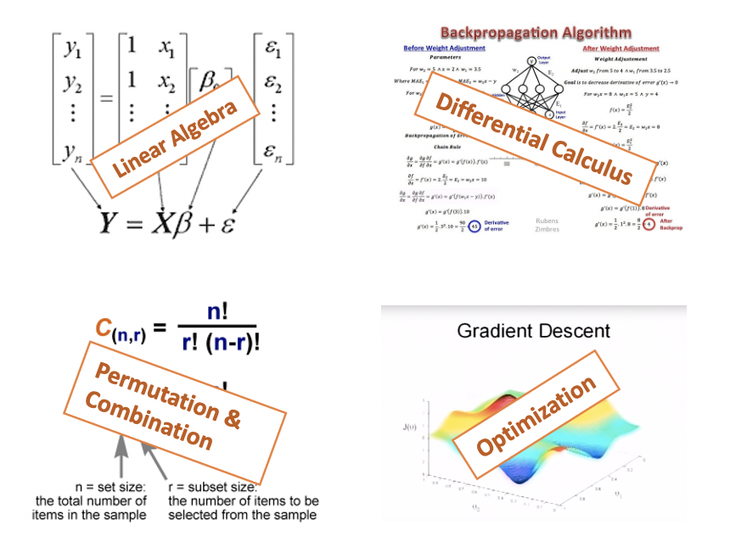
Math’s Fundamentals

Slide 5
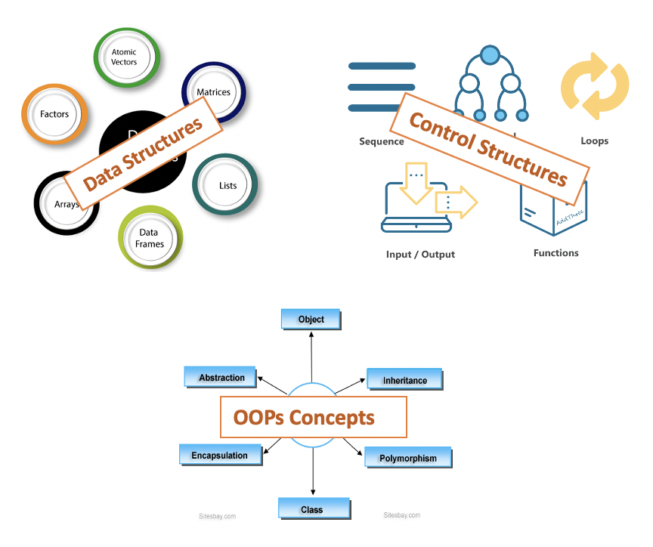
Programming Language

Slide 6
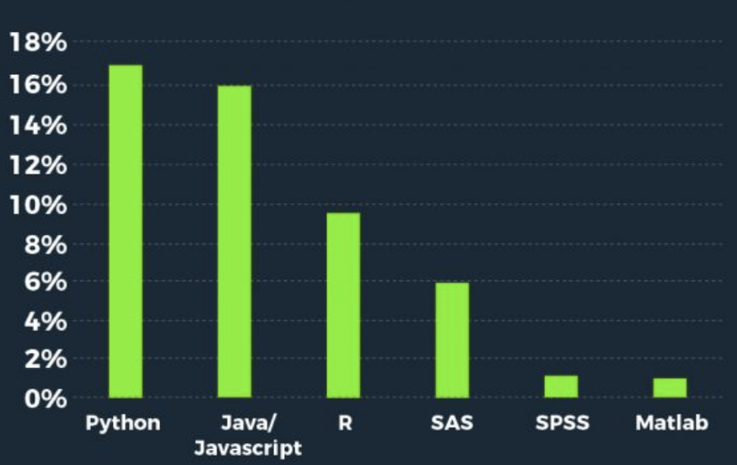

Slide 7
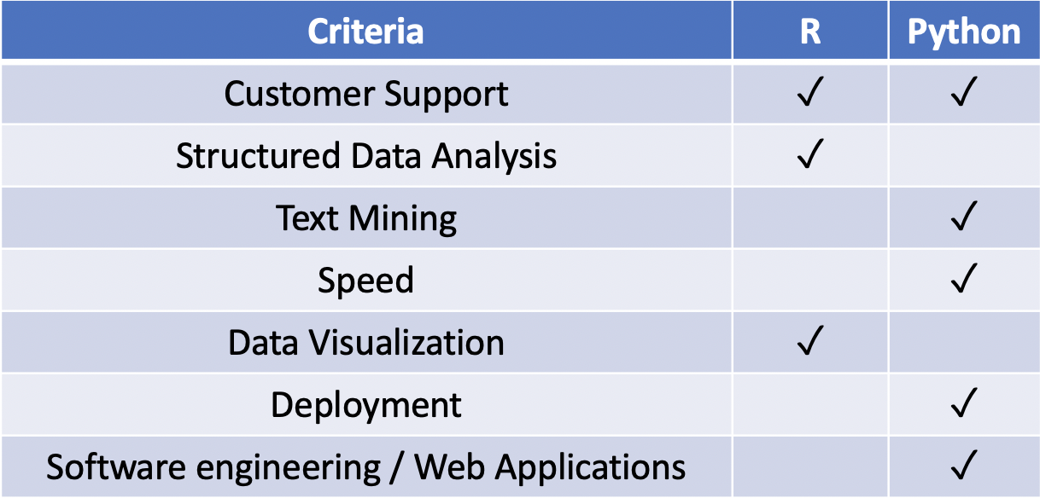

Slide 8
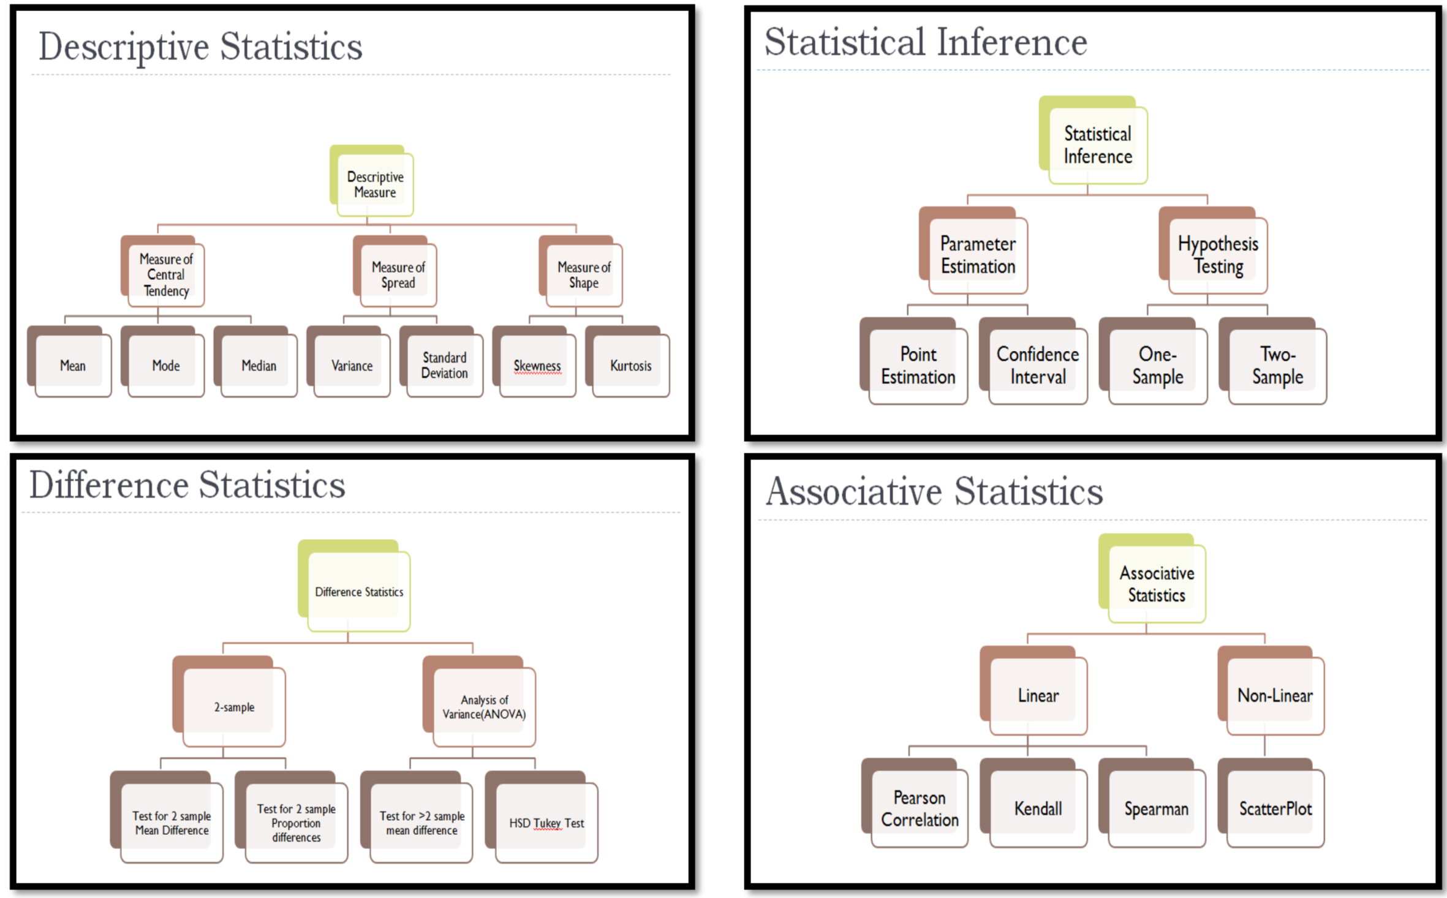
Statistics

Slide 9
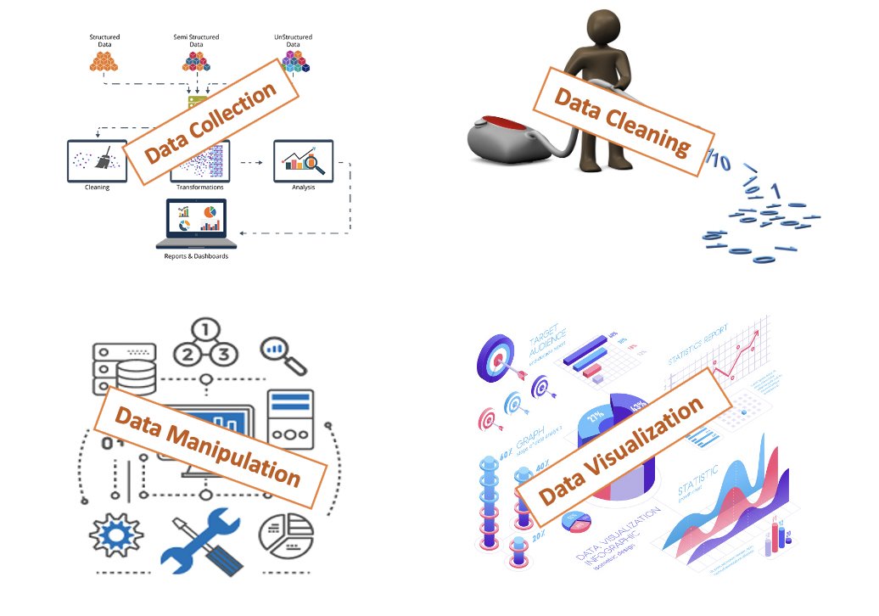
Data Collection and wrangling

Slide 10
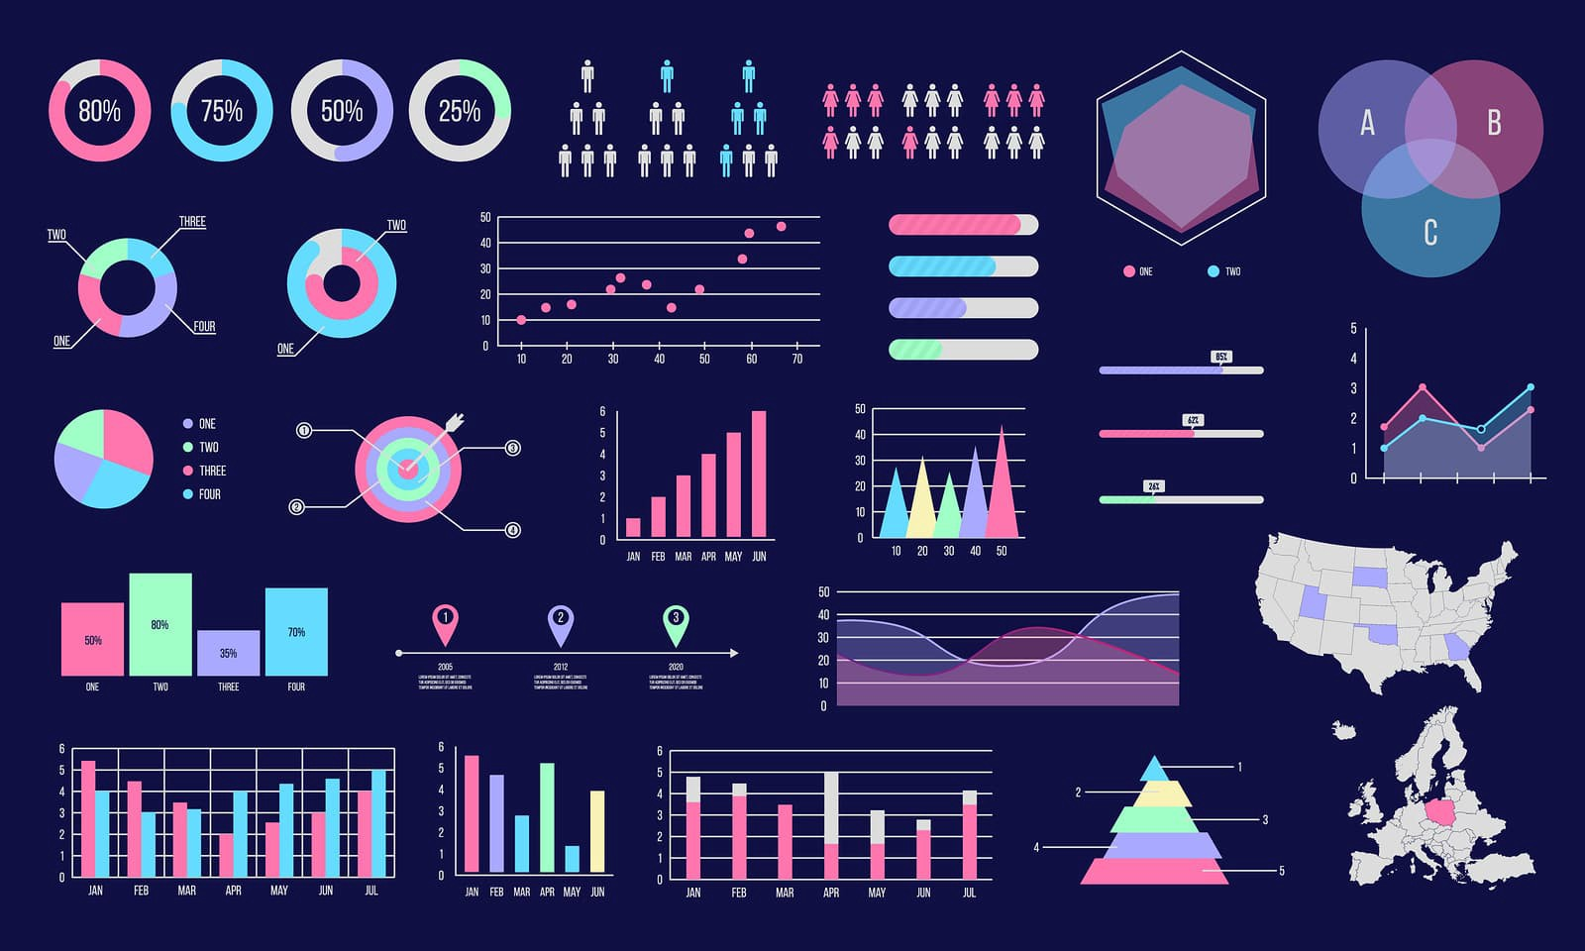
Data Visualization

Slide 11
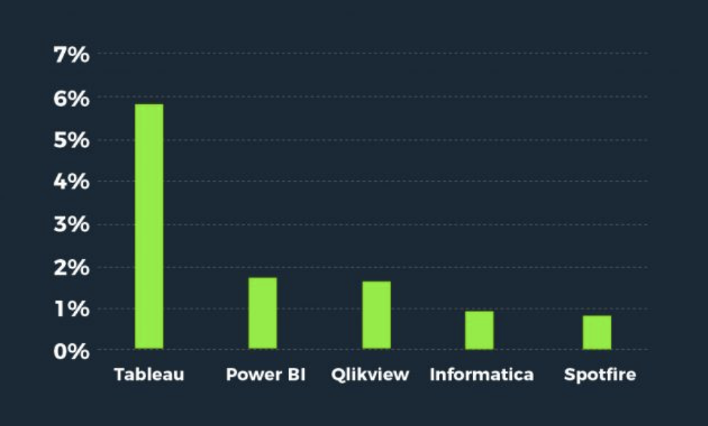
Tools for visualization

Slide 12
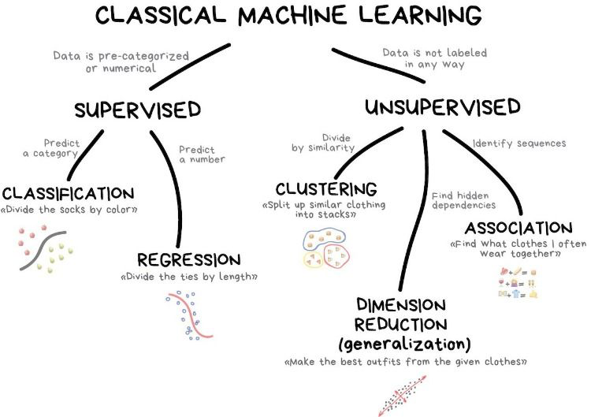
Machine Learning

Slide 13
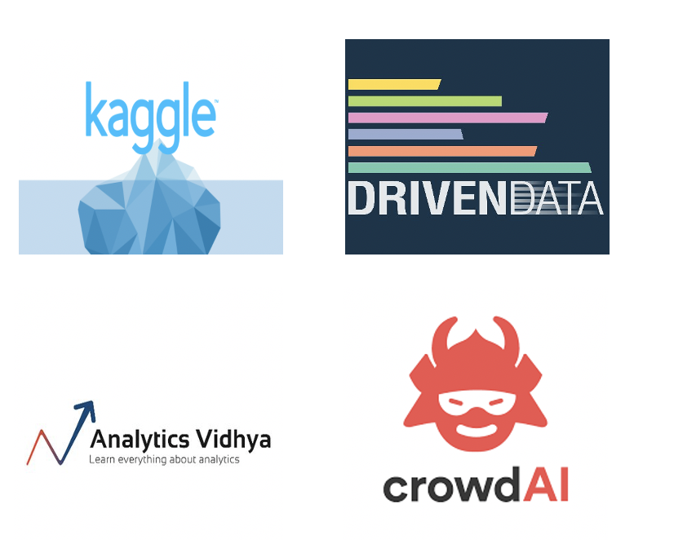
Data Science competitions

Slide 14
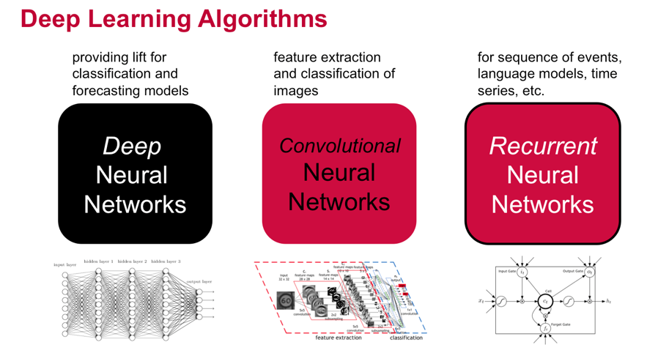
Deep Learning

Slide 15
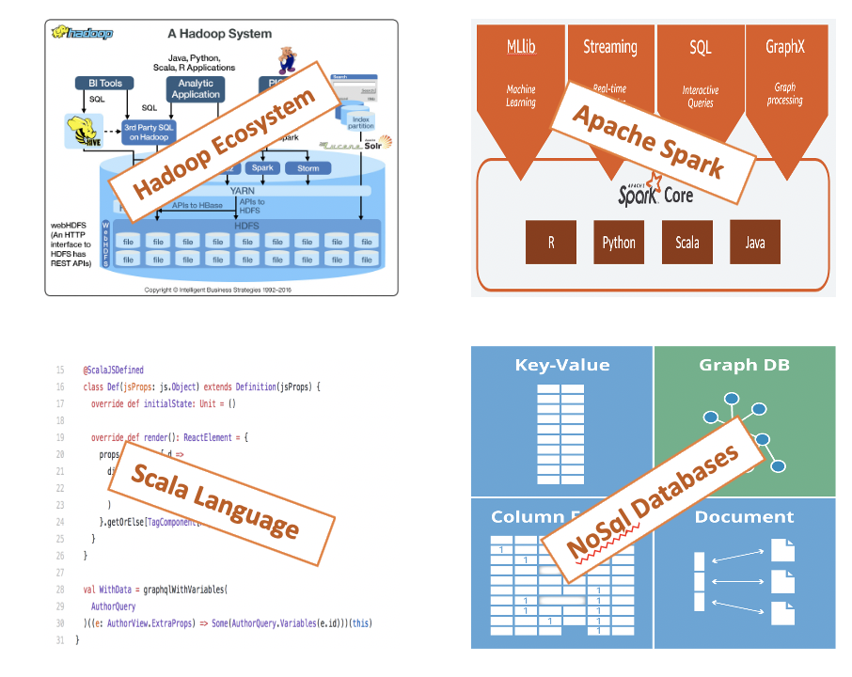
Big Data

Slide 16

Version control

Slide 17
Thanks for watching
Subscribe and press the bell icon

